Slide 1


TY Coding
Lesson 03 – Inputs and Strings

Slide 2


Part 01 Inputs

Slide 3

Taking User Input
Up until now, we have been doing calculations using variables that have been “hard coded”.
These programs would be more dynamic, if they could take in values from a user, rather than always using values we specify before run time.
Often in programs, we will want to take an input from a user.

Slide 4
Python has an input stream and an output stream.
We have already used the output stream.
Today we will be looking at the input stream.
print(“Hello world”)
input()

Slide 5
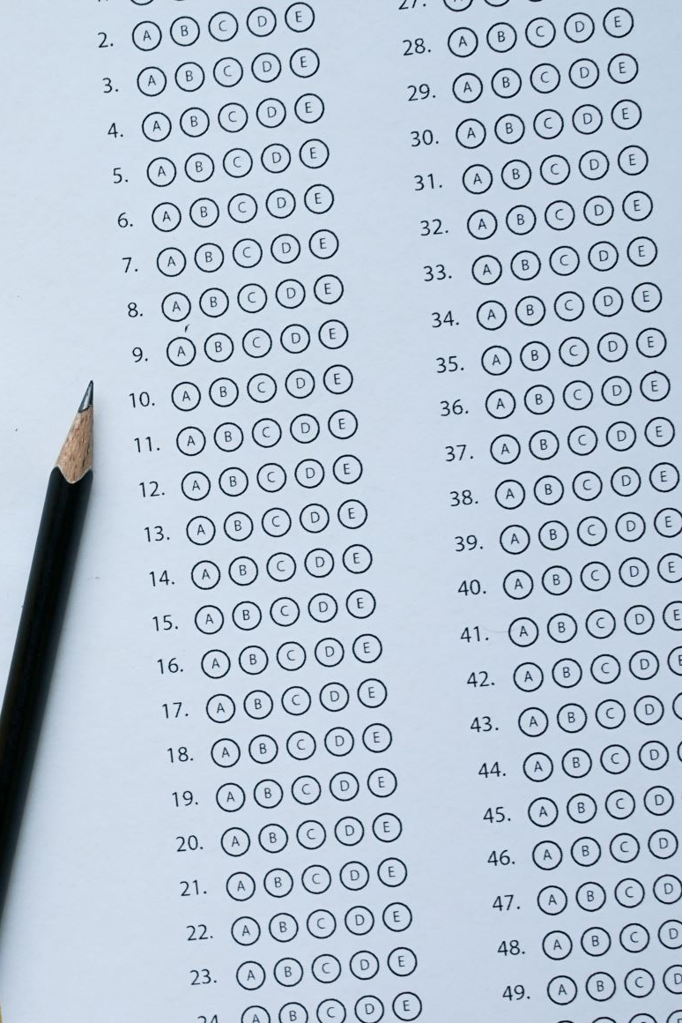
Taking User Input
We want to take in a user's name, store it in a variable called name and then print it back to them.
How do we do this?
Name = input()
Print(“hello”, name)
Do you remember what the brackets at the end of input mean?
It means that input() is a function or reusable piece of code that does a task for us.
The input function is used to take input from the user.

Slide 6




Taking user input
There is a problem with: name = input()
CODE
OUTPUT
Generally, you must “prompt the user”

Slide 7
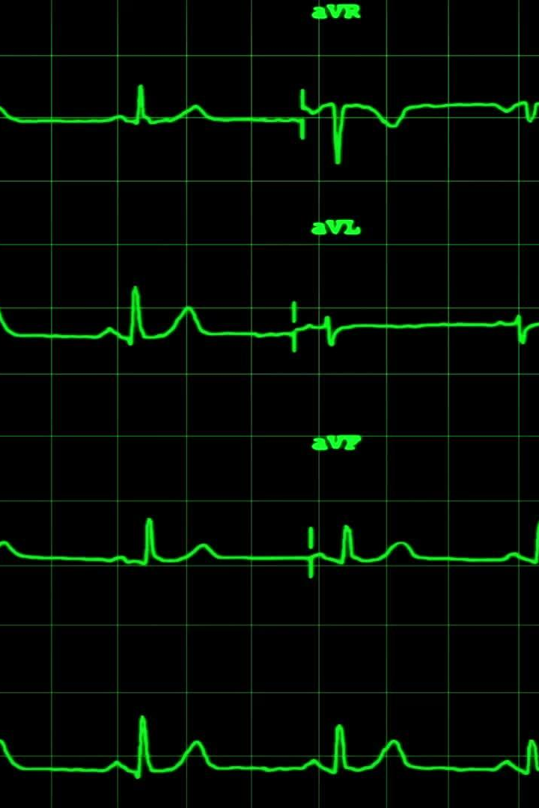
Taking User Input
We have taken in a string from the user.
The input function by default, takes in a string.
What if we want to take in a number? Such as an age.
We need to use the integer function to convert the user input from a string to an integer number.
Don’t worry, it is not that much different that taking in a normal user input.

Slide 8

We “wrap” the input function in the integer function like so:
Age = input(“please enter your age: ”) becomes:
Age = int(input(“please enter your age: ”))
Now, the variable age is an integer variable.
And we can do this with decimal numbers too, using the float function: float()

Slide 9
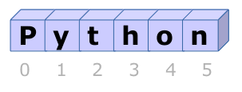
Part 2 - Strings

Slide 10
Strings
Strings in python are “immutable”
All this means is that they cannot change.
There are many operations and functions that can be used with strings.
We can add strings together:
string1 = “hello”
string2 = “world”
string3 = string1 + “ ” + string2
print(string3)
Output:
hello world
We can multiply strings
string1 = “hello”
string2 = string1 * 3
print(string2)
Output:
hellohellohello

Slide 11
Strings
We can use functions on strings, for example, we can:
Make the string upper case
my_string = “hello”
my_string = my_string.upper()
print(my_string)
Output:
HELLO
Make the string lower case
my_string = “HELLO”
my_string = my_string.lower()
print(my_string)
Output:
hello
Count the length of a string
my_string = “elephant”
length_of_string = len(my_string)
print(length_of_string)
Output:
8

Slide 12
Printing Formatted Strings
Concatenation (adding strings together)
name = “Alan”
age = 31
output = “Hello ” + name + “ you are + str(age) + “ years old.”
print(output)
Output:
Hello Alan you are 31 years old.
We need to wrap the age variable(which is an integer) in the string function: str(age) because:
When concatenating we can only add strings together, therefore we must convert the age variable into a string

Slide 13
Formatting
Formatting (using the format function)
name = “Alan”
age = 31
Output = “hello {0} you are {1} years old”.format(name, age)
Print(output)
Output:
Hello Alan you are 31 years old.
We can use the format function to create formatted strings. We use the {0} and {1} “place holders” to say where we want to place the variables in the string. Notice the place holder numbers start at 0!
Then we place those variables inside the brackets of the format function, in order as they appear in the string, separated by commas.
Here the variables name and age are used for the {0} and {1} place holders but this can be done as many times as you need.

Slide 14
Indexing
Strings have indexes, which are numbers that correspond to a certain character in a string.
In the above picture, we can see that the first character of the string “Python” has the index of 0.
That is because in Python, indexes always begin at 0.
If we wanted to print out the character that resides at the index of 3 for example, we can do this:
my_string = “Python”
print(my_string[3])
Output:
h

Slide 15
Slicing
We can use string slicing to cut a string into smaller strings.
my_string = “Python”
print(my_string[0:2])
Output:
Py
Why do you think only the first 2 characters printed out?

Slide 16
Slicing Continued
But wait! We wanted to print out the characters at the indexes from 0 up to 2. Why did only the characters at indexes 0 and 1 print out?
Because when using string slicing, we slice the string up to but not including the last index.
If we wanted to slice the string to include the first three characters, we would do: print(my_string[0:3])
This prints the characters at the indexes 0, 1 and 2 (the characters from index 0, up to but not including the index 3)
Output: Pyt

Slide 17
Summary
Today you learned about:
How to take input from a user
The input() function
That we need to convert to float and int if we want to take in whole or decimal numbers.
That we can add strings together using concatenation.
That we can multiply strings using the * operator.
That we can use the format() function to create formatted strings.
That strings have indexes that refer to each character.
We can print any character by choosing it’s index my_string[3]
We can choose to take a slice of a string by using string slicing my_string[0:3]
When using string slicing, we go from the first index chosen, up to by not including the last index chosen.

